Slide 1
Six Sigma Process
The Gap

Slide 2
Necessary Steps
Defining the problems to be fixes using a high-level roadmap.
Measuring the performance of the current process.
Analyzing the problem to get to the root cause of the problem(Go Lean Six Sigma, n. d).
Improving the system using holistic and elegant solutions.
Controlling the system to ensure sustainability of gains.

Slide 3
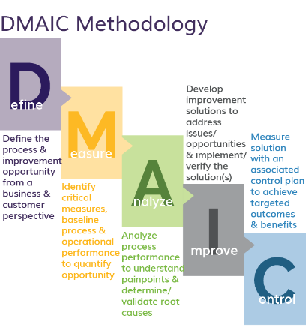
Defects’ Removal
Creating robust design.
Analyzing the effects.
Assessing the reliability and capability of the system to remove the risk.
Enhancing the performance of the system.

Slide 4
Reference
Go Lean Six Sigma, DMAIC- The 5 phases of lean six sigma. Retrieved from
https://goleansixsigma.com/dmaic-five- basic-phases-of-lean-six-sigma/

